Slide 1
Internship Orientation
Volette Polloi | Spring 2024

Slide 2
Overview
Purpose and Goals of Internship/Service Learning
Required Documents and Placement Process
Required Contact Hours
Basic Workplace Etiquette and Protocols
Completion of Internship
Termination of Internship/Service Training
Common Concerns and How to Deal with Them

Slide 3
The internship program is a collaborative training arrangement between the college and employer; it provides students the opportunity to acquire educationally related work experience; students are able to enhance their skills, which may lead to permanent employment or to pursue further education.
To promote the development of skills and abilities relevant to productive employment to meet the needs of the communities.
To assist graduates in obtaining meaningful and productive employment.
To promote the participation of community and employers in curriculum review and development.
To assist in providing trained local manpower to meet the needs of the community.
Purpose of the Internship Program
Goals of the Internship Program

Slide 4
Placement Process
After the student has registered and applied, request letters (for employers to allow student interns/service learners) are sent out to the agencies by the college
If an agency agrees to the request, a placement meeting is scheduled (Employer, Internship Coordinator, Intern/Service Learner)
If an agency denies the request, we go back to Step 1
DURING THE PLACEMENT MEETING
The Internship Coordinator will introduce the student intern to the employer,
distribute and explain the internship packets.
PACKETS:
Student Packets
* Internship Syllabus
* Internship Guidelines
* Task List
* Student Evaluation
* Timesheet (Depending on Agency)
The employer may ask some common interview-type questions. E.g. “What do you expect to learn?”, “Why did you choose our agency?”
Employer Packets
* Internship Syllabus
* Internship Guidelines
* Task List
* Employer Evaluation
At the conclusion of the meeting, an agreement will be signed by all parties involved. This agreement will ensure that everyone involved is aware of their respective responsibilities during this time.

Slide 5
REQUIRED Contact HOURS
For the following programs:
AG, BA, BU, CJ, IT, LS, OA, PW, SC, TH
96 hours at the worksite (before semester ends)
For the following programs:
AC, CT, ED, ET, GE, SE
128 hours at the worksite (before semester ends)
Incomplete Hours = Failing Grade and Internship will be repeated
Your class schedules will indicate the “class times” of 8:00 a.m. – 5:00 p.m. HOWEVER, your schedule is flexible, provided that it is approved by your work supervisor. You are recommended to work a minimum of 3-4 hours each day, but no more than 8 hours a day.

Slide 6
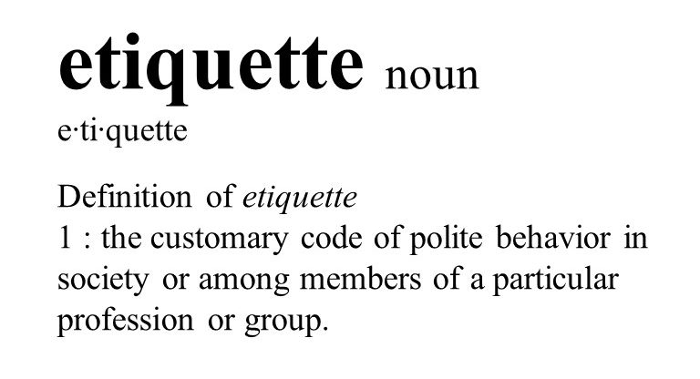
Workplace etiquette
Arrive on time/Follow the approved work schedule
If work is missed, inform the appropriate person at least 24 hours ahead of time. Bring a doctor’s note if you were sick. Keep in mind that missing hours have to be made up!
Dress appropriately following the agency’s protocols (E.g. Business casual, skirts/slacks, blouse, safety shoes)
Use your indoor voice and speak professionally (avoid slang and no profanity)
Use professional protocols (communication, safety, confidentiality)
Do not conduct personal business during work time (personal calls/errands, social media, visits)
Show initiative and be courteous (do the extra work, be a team player!)
Keep an open mind: Be ready to learn, adapt, and change!
NETWORK!!

Slide 7
Termination of internship/service learning
Students may have their internship/service learning terminated if they:
Violate workplace regulations/policies
Violate PCC’s regulations/policies
Students whose internships/service learning are terminated for any of the above reasons or due to any unethical circumstances will not receive college credit
Do not show up to work/lack contact hours
Are unable to perform the required duties/skills needed for the internship

Slide 8
Common concerns
Internship concerns may include the following:
Responsibilities different from those outlined in your Task Lists
WHO TO CONTACT REGARDING ANY CONCERNS
Inform your site supervisor
Contact me immediately!
Bias (age, race, religion, etc)
Harassment
My contact information:
Office: 2nd floor of Temekai Building
E-mail: volettep@palau.edu
Office Phone: 488-2659 Mobile: 775-7065
Messenger: Volette Polloi
Lack of training / supervision
Deficiency of work

Slide 9
You’ve Completed the hours! What now?
Let your supervisor know and remind them to evaluate you.
Double check your timesheets and make sure your supervisor has signed/certified your completed hours.
Fill out your evaluation (remember! It’s back to back)
Submit these three documents to me so I can compute your grade ☺
Last day to submit documents: May 3, 2024
And YOU’RE DONE!!

Slide 10
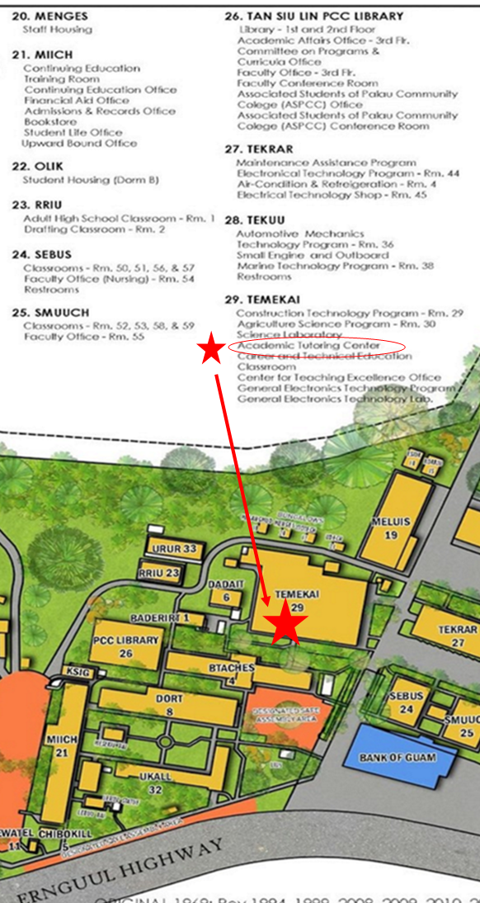
Contact information
Academic Tutoring Center PCC Temekai Building, 2nd Floor
Facebook Group Page PCC Spring Internship 2024
Messenger Volette S. Polloi
Email volettep@palau.edu
Contact Numbers 488-2659/775-7065

Slide 11
Questions? Comments? Random Thoughts?

Slide 12
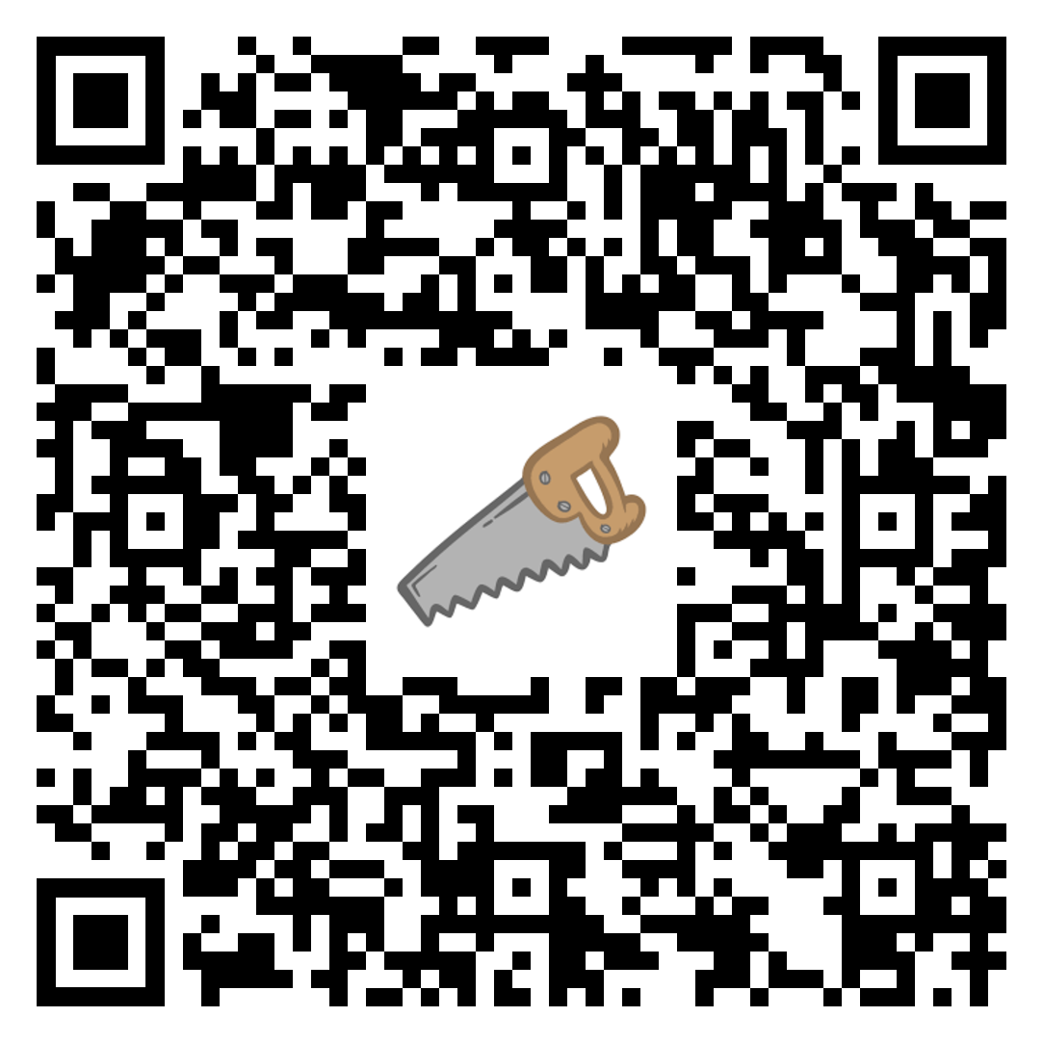
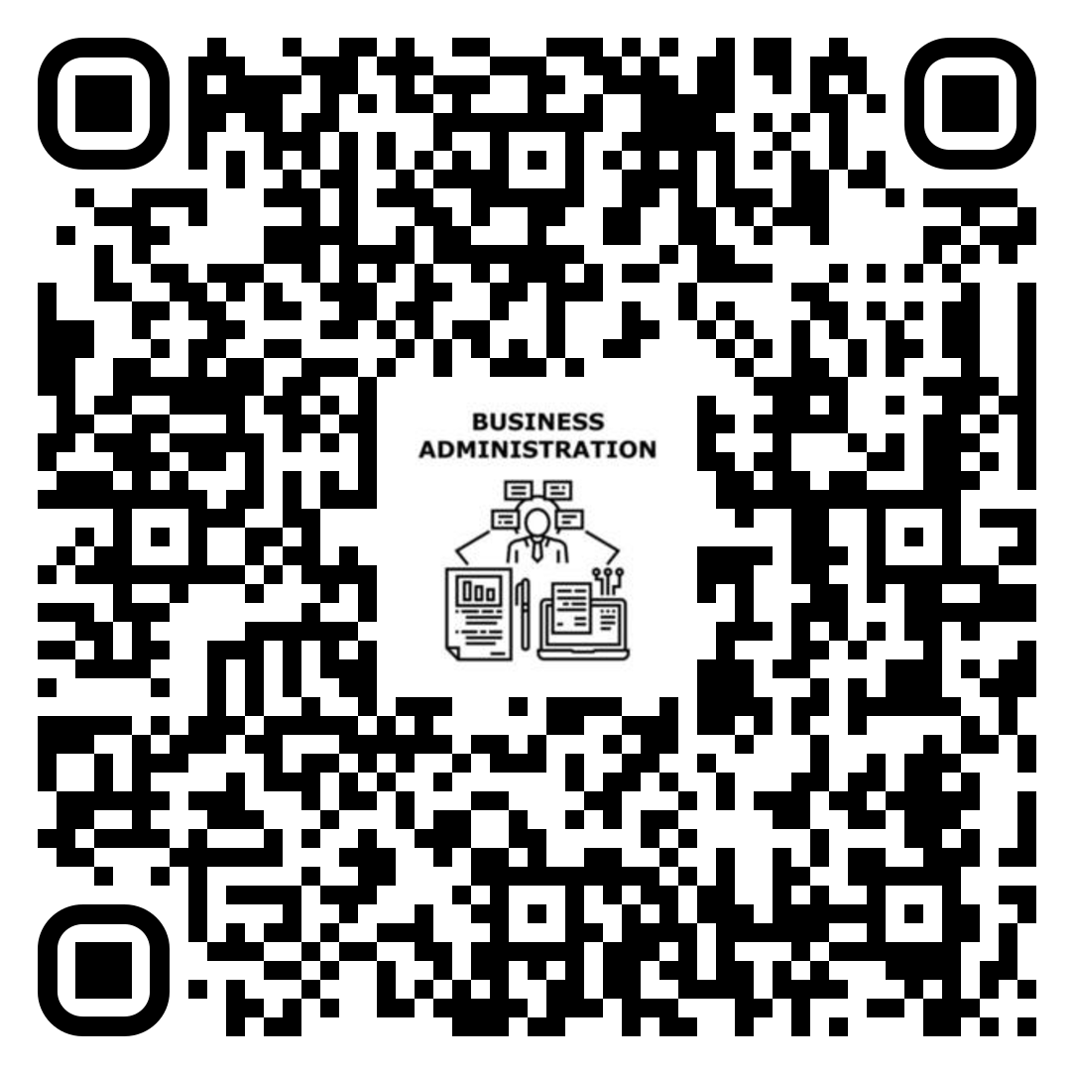
SCAN YOUR PROGRAM QR CODE TO OBTAIN YOUR INTERNSHIP DOCUMENTS. SCAN THE FB CODE TO JOIN THE FB GROUP.

